Slide 1
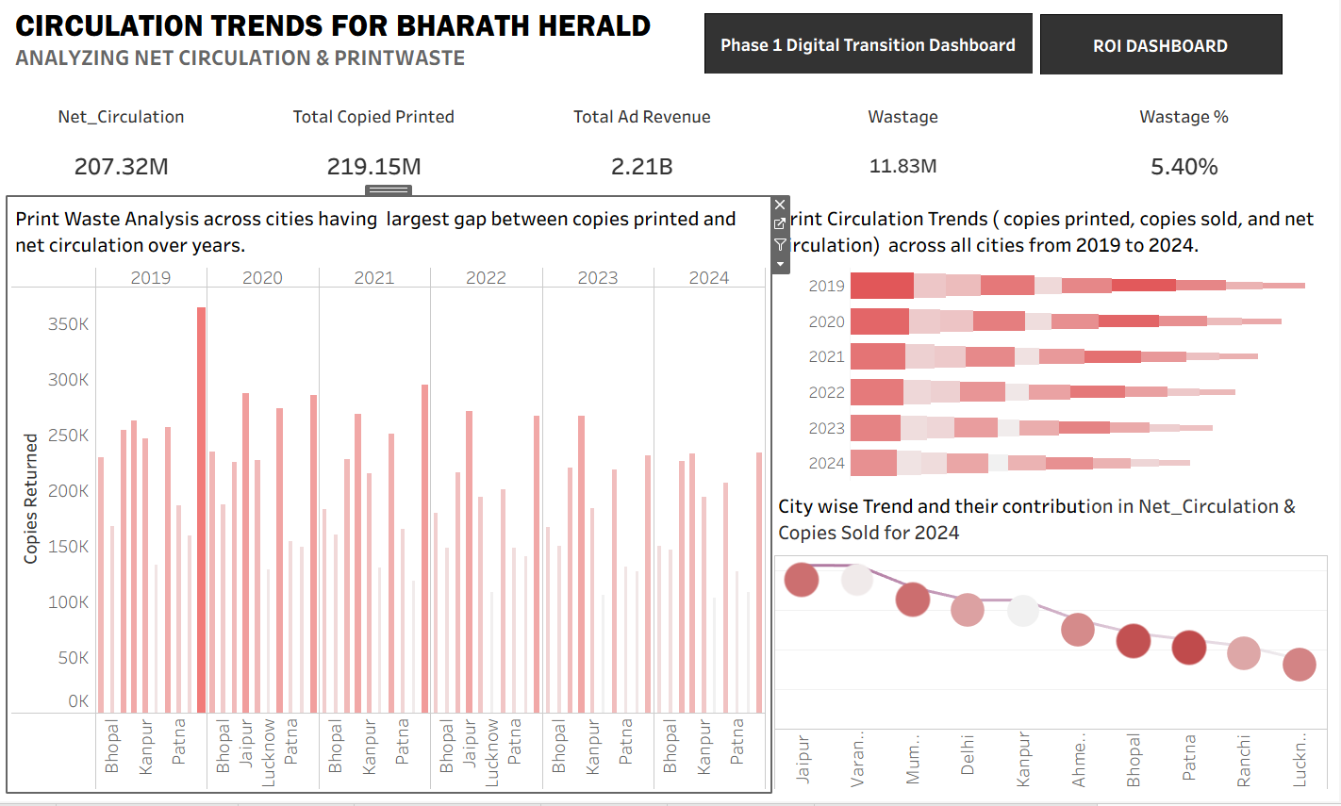
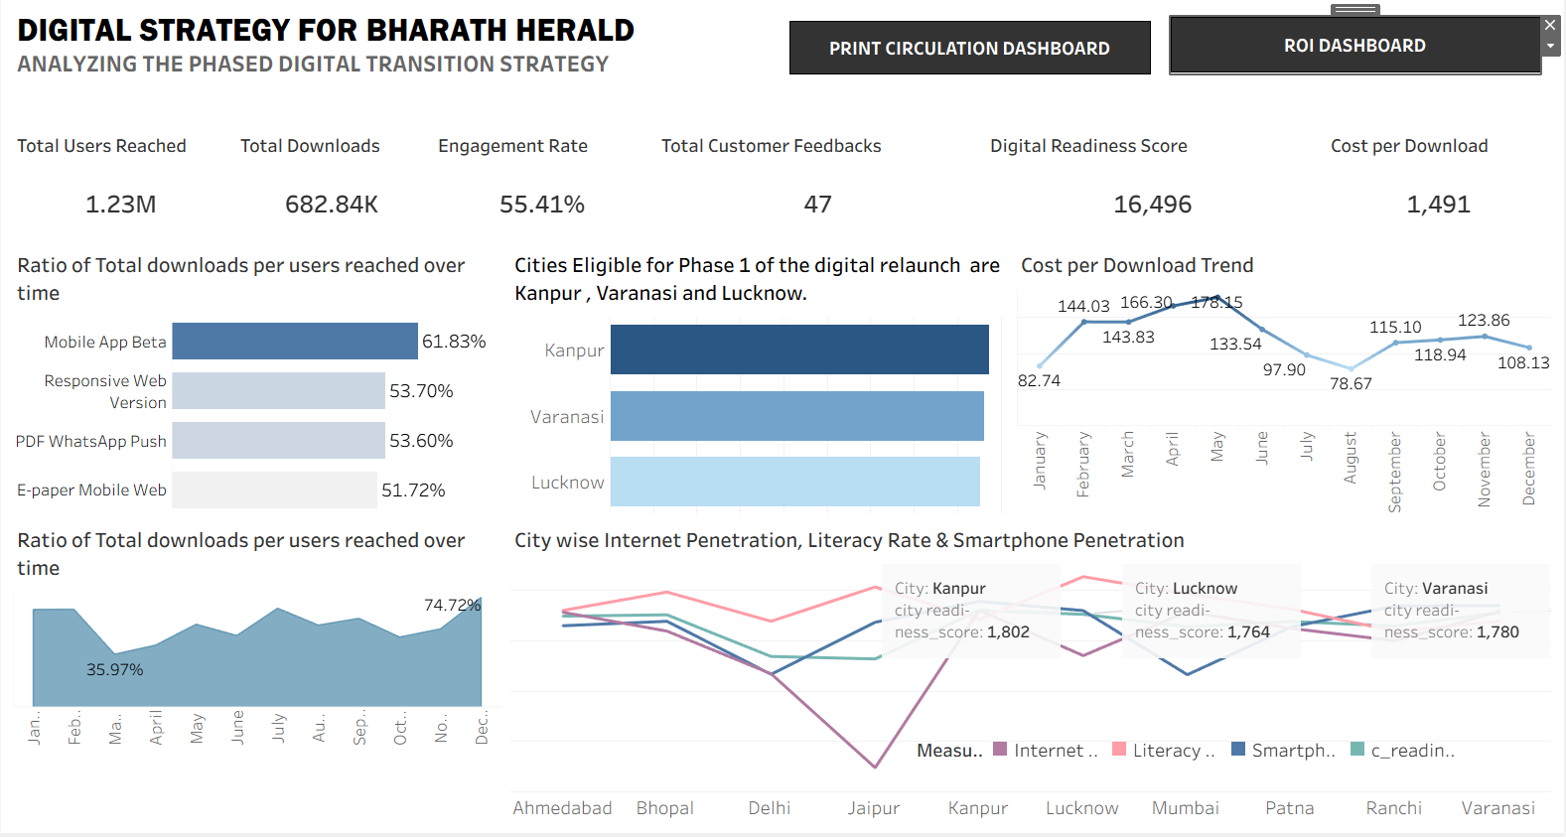
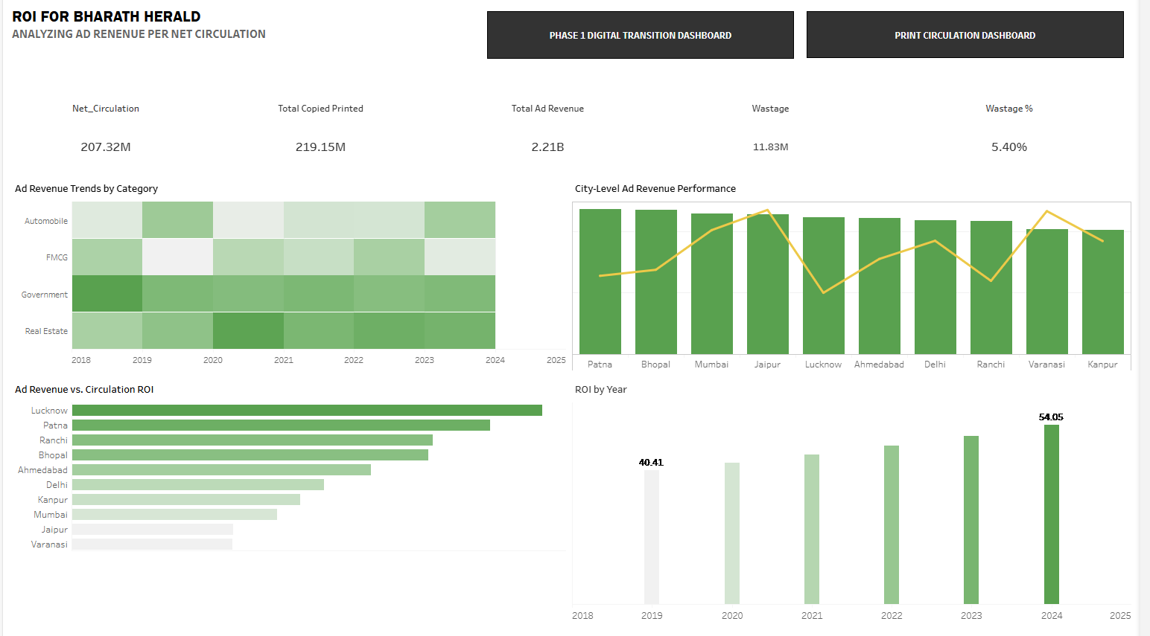
BHARAT HERALD SURVIVAL ANALYSIS

Slide 2




Project
Summary
Data Model
Charts & Insights
Dashboard

Slide 3
Project Summary
Extract the Data
Bharat Herald, a legacy newspaper organization with operations across five Indian states, is facing an existential crisis. With a reputation built over seven decades for multilingual reporting and sharp regional journalism, the company once printed over 1.2 million copies daily.
But between 2019 and 2024, print circulation has dropped to under 560,000. The pandemic accelerated a shift toward digital news consumption, and competitors like DigiHindi Post, NewsZilla, and InShorts quickly adapted with mobile-first platforms, WhatsApp delivery models, and subscription bundles. Meanwhile, Bharat Herald’s 2021 e-paper pilot failed due to poor mobile usability and was eventually shelved after financial losses.
The result: advertiser confidence declined, vendor payments delayed, and multiple city bureaus shut down.
Create Dashboard
Clean the Data
Project Pipeline
Create Visuals
Transform the Data
Analyse the Data

Slide 4
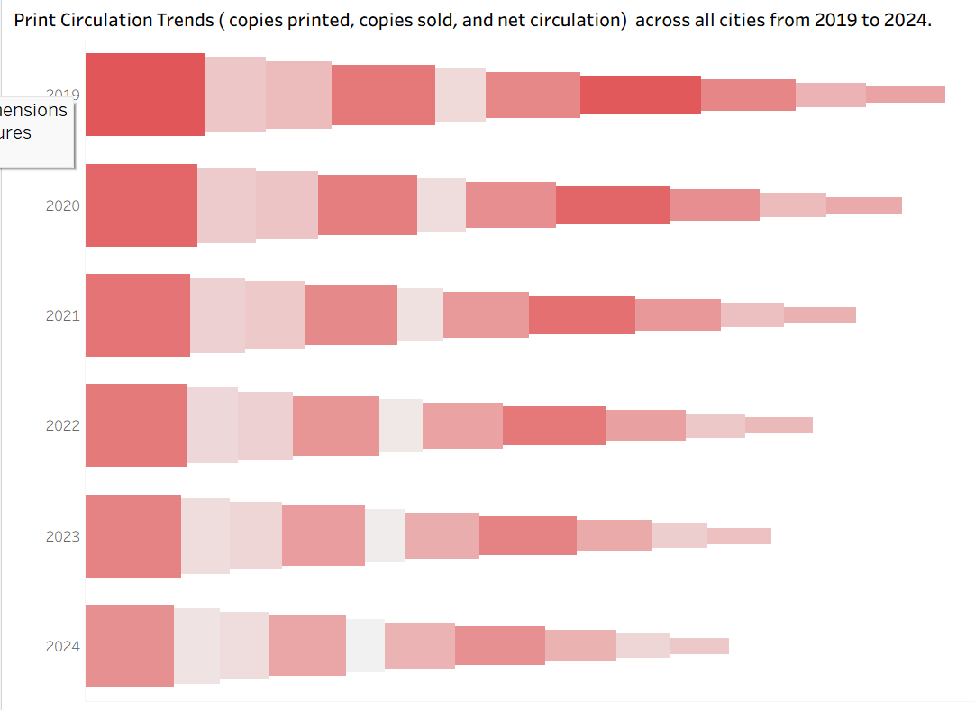
Questions from the available data
1. Print Circulation Trends What is the trend in copies printed, copies sold, and net circulation across all cities from 2019 to 2024? How has this changed year-over-year?
since copies printed is the same as copies sold we can find the correlation between copies sold and net circulation across cities over 2019-2024
there is a steady decline in net circulation and copies sold across cities as years pass by

Slide 5
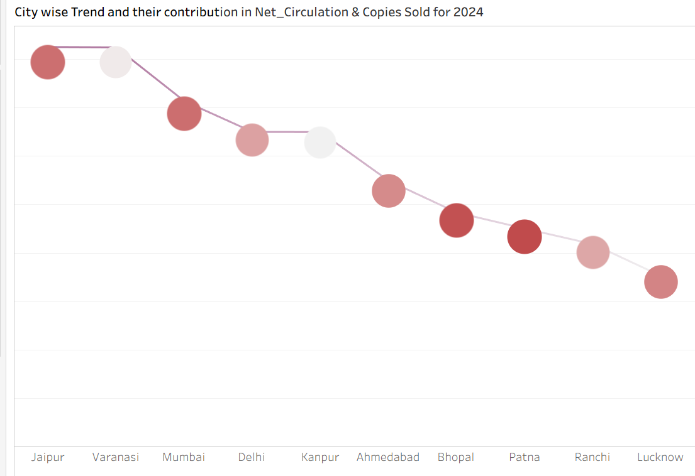
Questions from the available data
2. To Performing Cities Which cities contributed the highest to net circulation and copies sold in 2024? Are these cities still profitable to operate in?
Jaipur & Varanasi are the highest net circulation and copies sold in 2024
However Varanasi is not profitable with its ad revenue has gone down and fallen into lowest.
Patna and Bhopal in spite of having significantly less copies sold are highly profitable with ad revenue shown in dark maroon

Slide 6
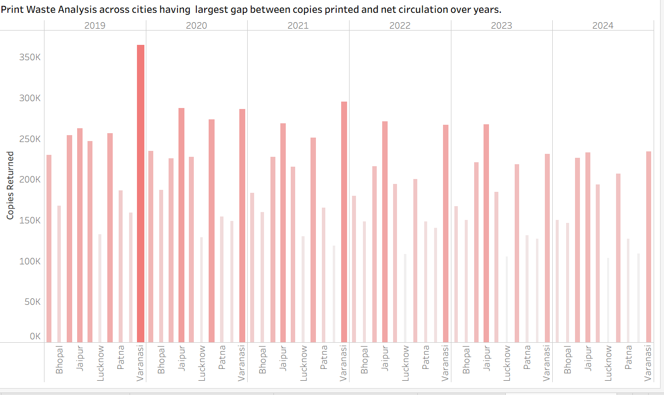
Questions from the available data
3. Print Waste Analysis Which cities have the largest gap between copies printed and net circulation, and how has that gap changed over time?
Varanasi has shown the highest print waste however over time the print waste has gone down significantly
As we can see in 2019 print waste for Varanasi was 315 M it has reduced to 202 M by year 2024
Overall print waste has reduced across all cities over time.

Slide 7
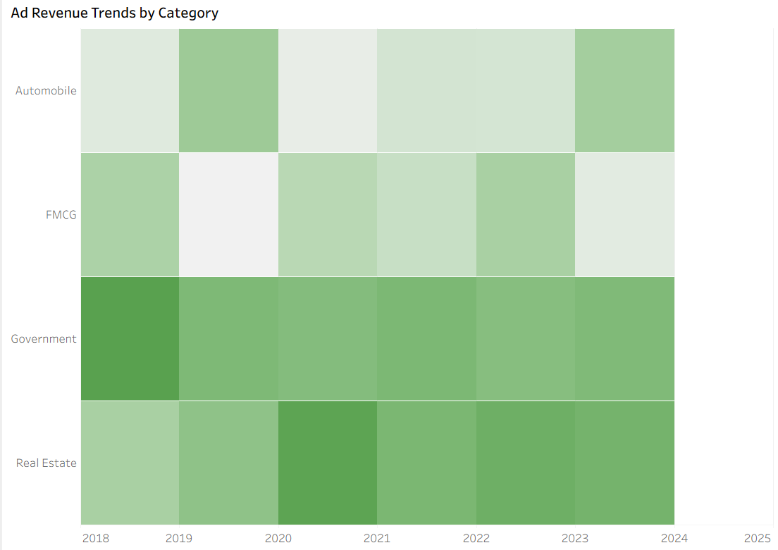
Questions from the available data
4. Ad Revenue Trends by Category How has ad revenue evolved across different ad categories between 2019 and 2024? Which categories have remained strong, and which have declined?
from the map colours we can see that Government sector has increased in ad revenue generation over the years from 2019 to 2024
Followed by Real Estate though it dipped however it maintained consistency and showing a over all growth rate designated by darker green hues

Slide 8
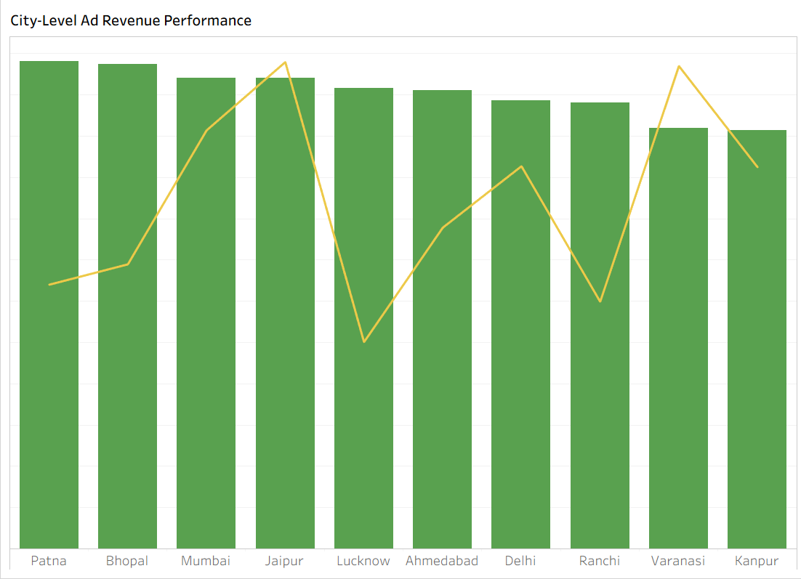
Questions from the available data
5. City-Level Ad Revenue Performance Which cities generated the most ad revenue, and how does that correlate with their print circulation?
in spite of Patna having a lower circulation it tops the ad revenue followed by Bhopal and Mumbai.
Also we notice that Varanasi being the second highest in net circulation falls among one of the lowest in ad revenue generation.
This shows the ad revenue performance is not directly proportionate to the net circulation

Slide 9
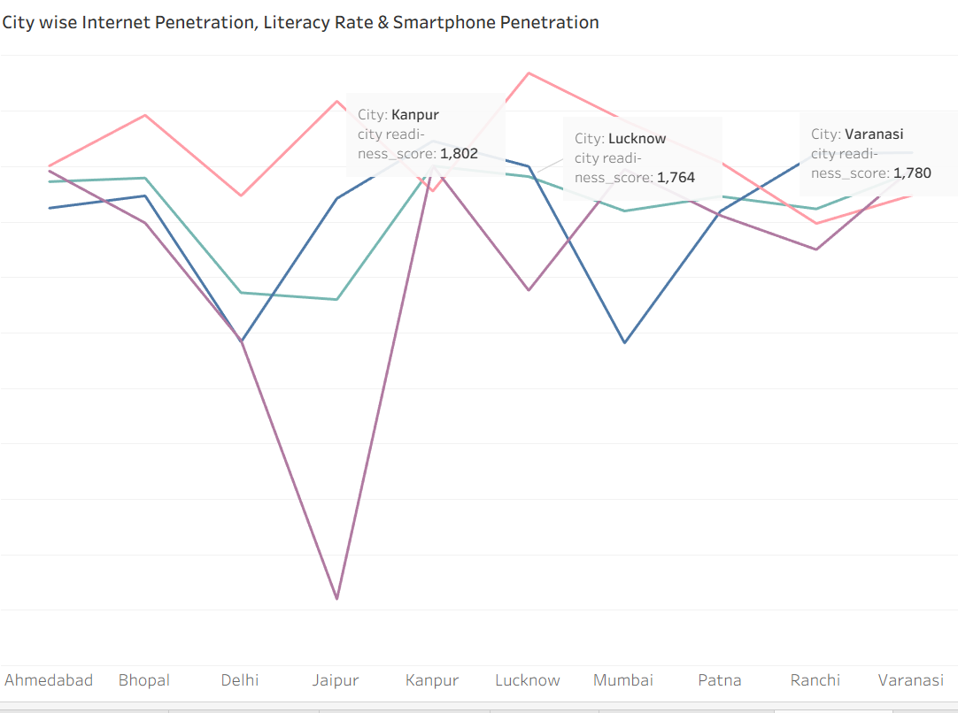
Questions from the available data
6. Digital Readiness vs. Performance Which cities show high digital readiness (based on smartphone, internet, and literacy rates) but had low digital pilot engagement?
Kanpur Varanasi and Lucknow are the cities with high digital readiness but low in digital engagement

Slide 10
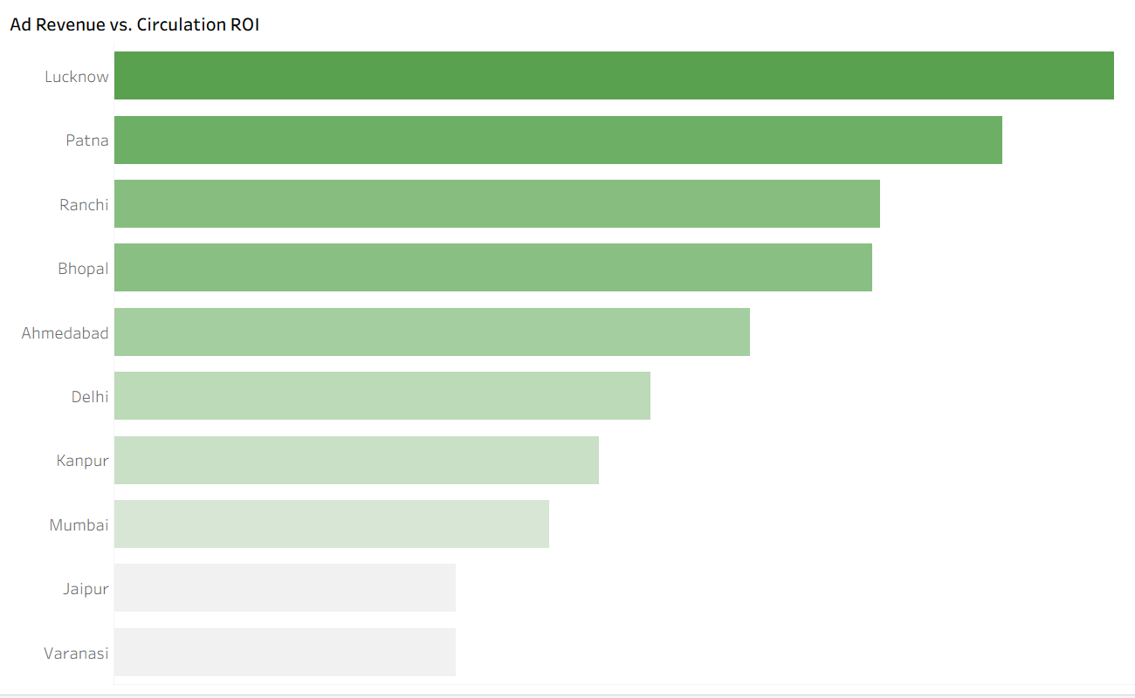
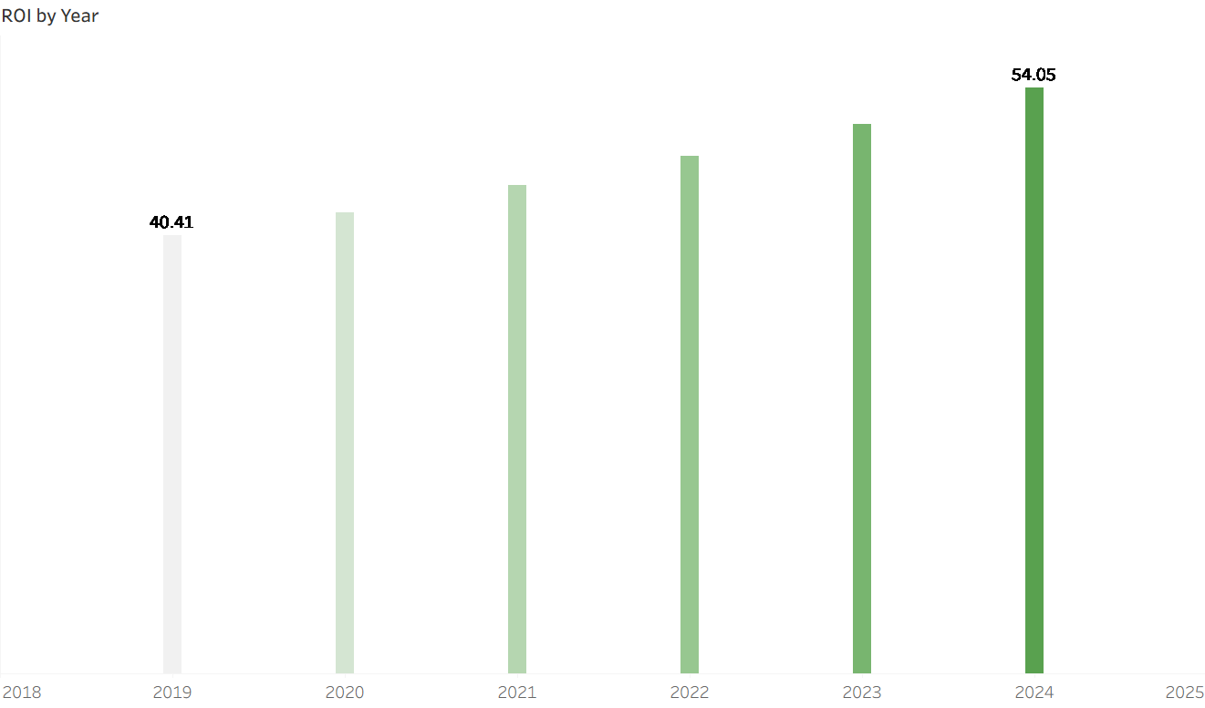
Questions from the available data
7. Ad Revenue vs. Circulation ROI Which cities had the highest ad revenue per net circulated copy? Is this ratio improving or worsening over time?
Lucknow , Patna and Ranchi had the highest ad revenue per net calculation.
The ratio is definitely improving over years

Slide 11
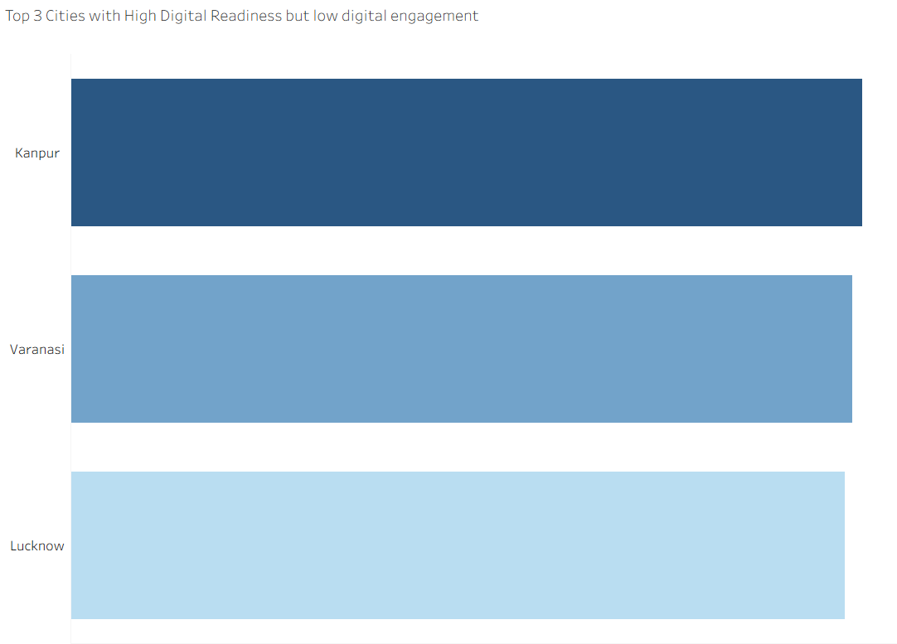
Questions from the available data
8. Digital Relaunch City Prioritization Based on digital readiness, pilot engagement, and print decline, which 3 cities should be prioritized for Phase 1 of the digital relaunch?
Kanpur Varanasi and Lucknow are the cities with high digital readiness but low in digital engagement

Slide 12
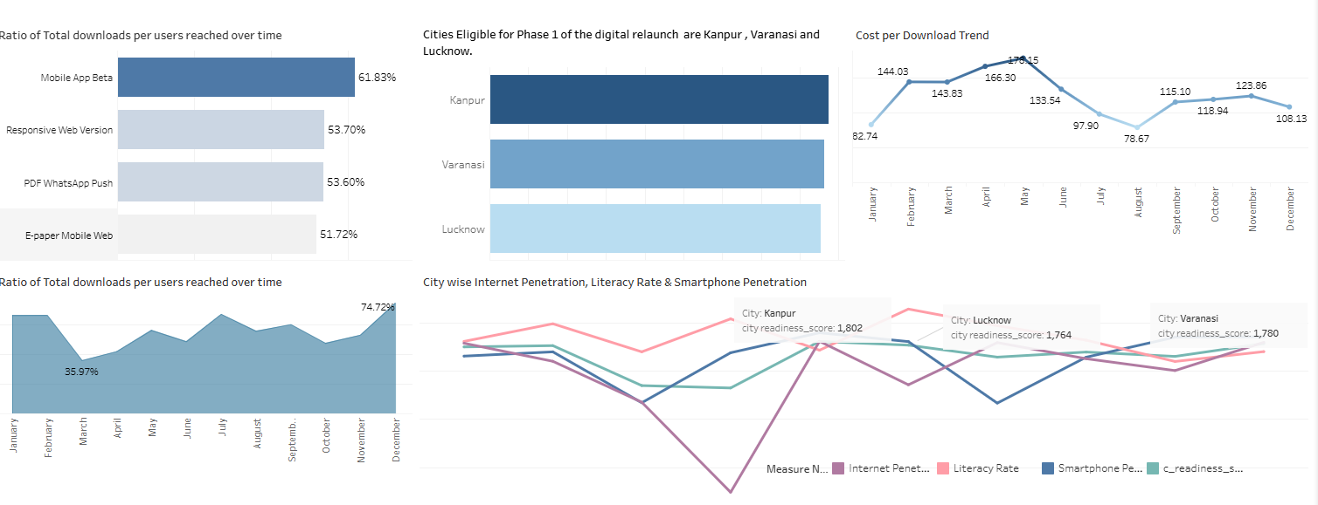
Secondary Analysis
It not only analyzed that Kanpur Varanasi and Lucknow are the cities with high digital readiness but low in digital engagement
We can also find out Was it too expensive (CPD)?
Looking at the Cost per Download rates
We notice that ratio of total downloads per users reached is recorded highest in the month of December and the cost per download rate is 108 INR which is the third lowest from this we can see a pattern that lower the cost more downloads.
We have also found out that highest no of downloads and user reached were on Mobile App Beta

Slide 13
THANK YOU

